Slide 1
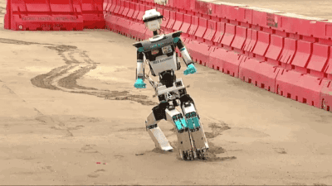
OVERFITTING: THE BIG LIMITATION IN AI

Slide 2
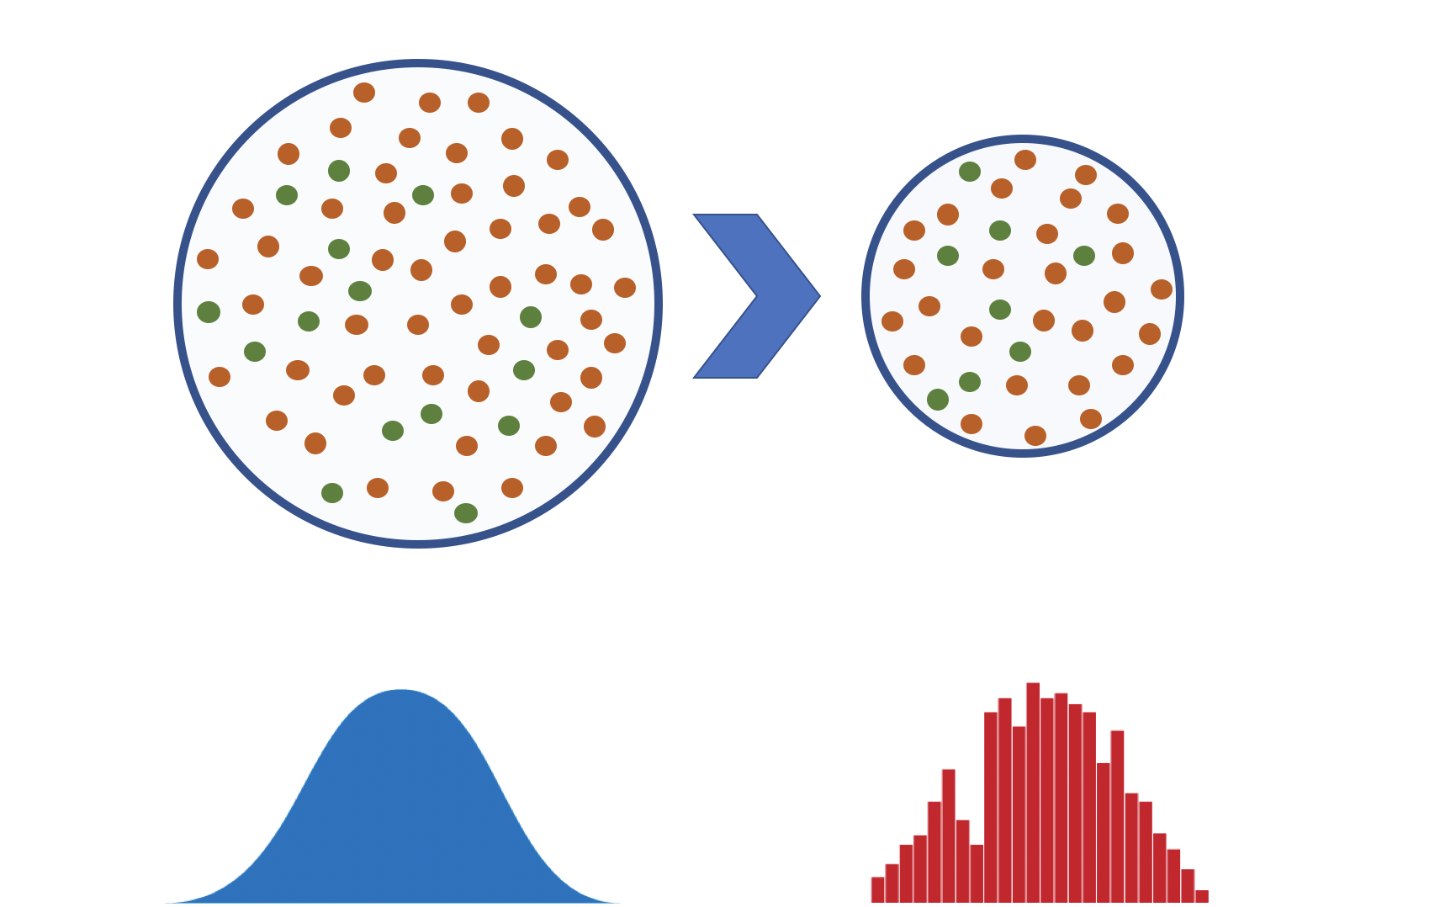
“ N O T T H A T E A S Y . . . “
EMPIRICAL RISK MINIMIZATION
We are talking about "empirical risk minimization", that is to say we have a dataset which we consider being drawn from an underlying data distribution, from which we would like to learn something. We do not know the true, underlying distribution (the true, underlying relationships), so we estimate the model that best represents the relationships presented in the available empirical data. In order to do so, we minimize the "empirical risk", that is we select the model that performs best on the empirical data we have obtained.
“It is difficult to do predictions, especially about the future!”
- attributed to Niels Bohr (and some others)

Slide 3

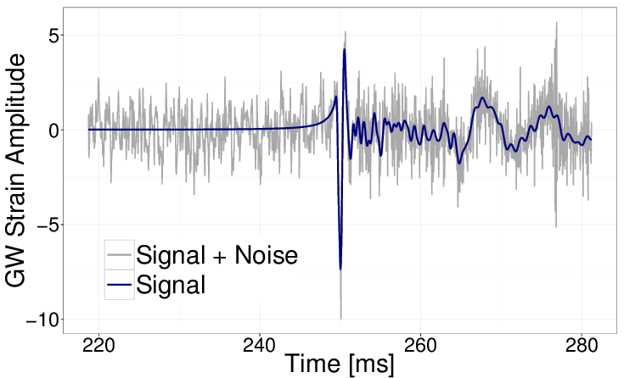
“NOT THAT EASY...“
SAMPLING HAS ITS DRAWBACKS

Slide 4
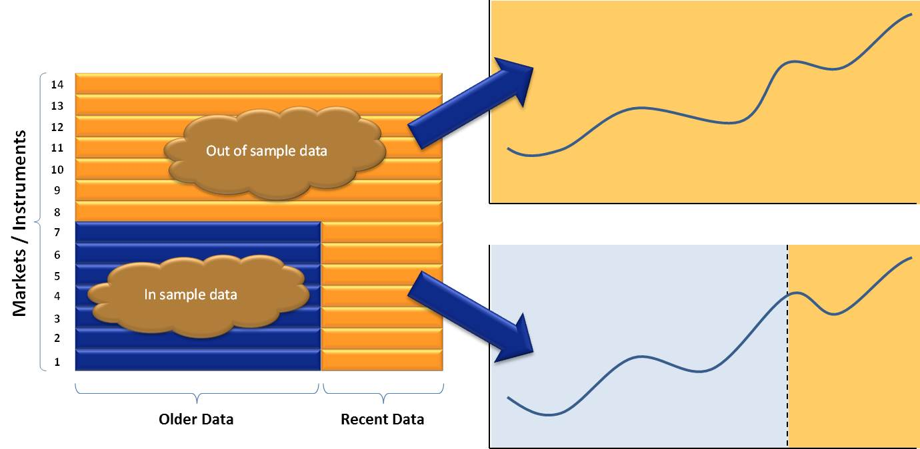
“DON’T JUST FIT”
ALWAYS VALIDATE AND TEST!

Slide 5
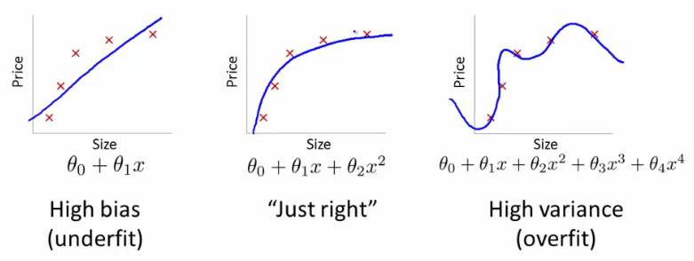
“DEGREES OF FREEDOM“
OVERFITTING IS DANGEROUS

Slide 6
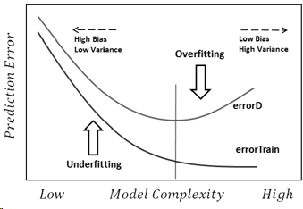
“DON’T JUST FIT”
ALWAYS VALIDATE AND TEST!
s o u r c e :
Statistical learning theory
Vapnik–Chervonenkis dimension

Slide 7
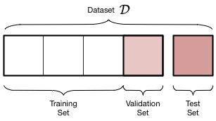
“ D O N ‘ T C O N T A M I N A T E T H E P R O C E S S ! “
UNBIASED ESTIMATES ARE TO BE PRESERVED!
If we make decisions based on a held-ot data, it’s information content will influence our model. It is no longer an unbiased estimate of performance!
We need TWO held out datasets, one we use for decisions, the other WE NEVER TOUCH, just before deployment, as an estimate for performance.
If we use a dataset, “accidental contamination” can occur. (by normalization, by hyperparameter optimization, by feature selection, ...)
NEVER TOUCH TEST
s o u r c e :
Accidental contamination
Selection bias

Slide 8
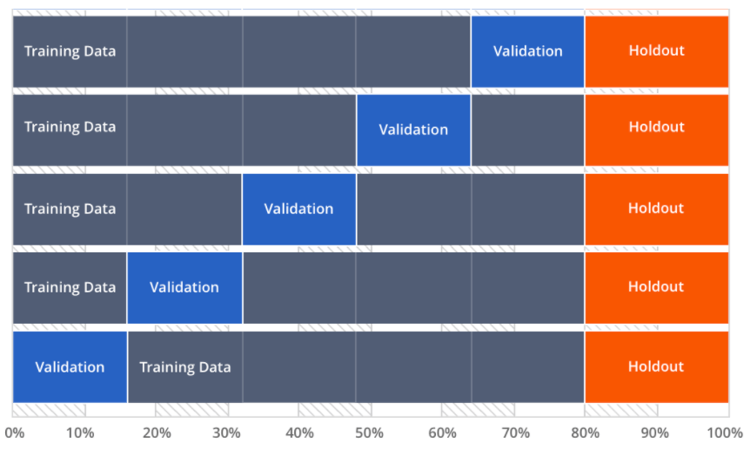
“DON’T JUST FIT”
ALWAYS VALIDATE AND TEST!

Slide 9
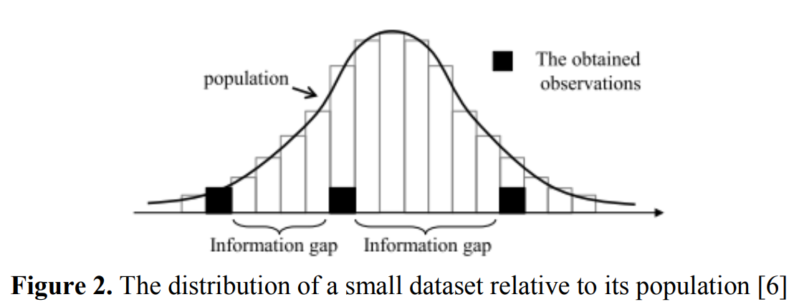
“NOT ENOUGH INFORMATION”
SMALL DATASETS VIOLATE BASIC ASSUMPTIONS
s o u r c e :
‘Handling a Small Dataset Problem in Prediction Model by employ Artificial Data Generation Approach: A Review’

Slide 10
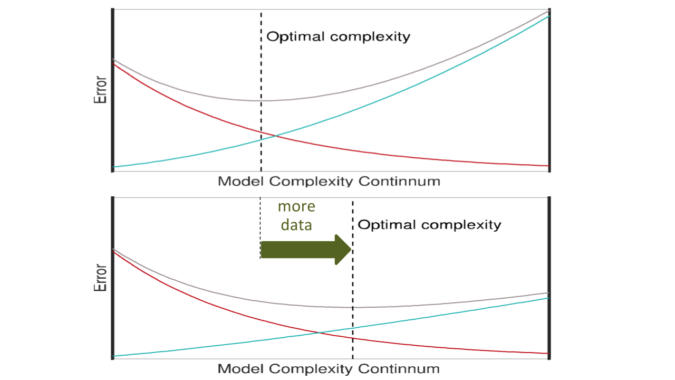
“DON’T JUST FIT!”
...AND ADD DATA!
s o u r c e :
“Lecture series of Michael C. Mozer at DeepLearn2017 Bilbao”

Slide 11
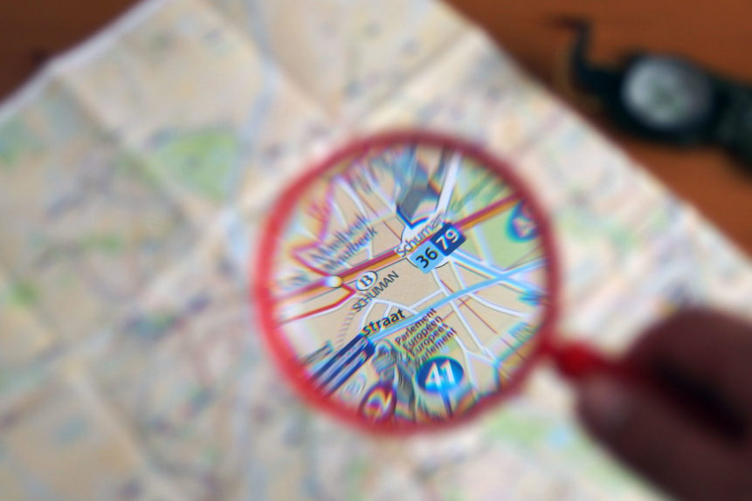
THE CASES OF SMALL DATA (DATA QUANTITY)

Slide 12
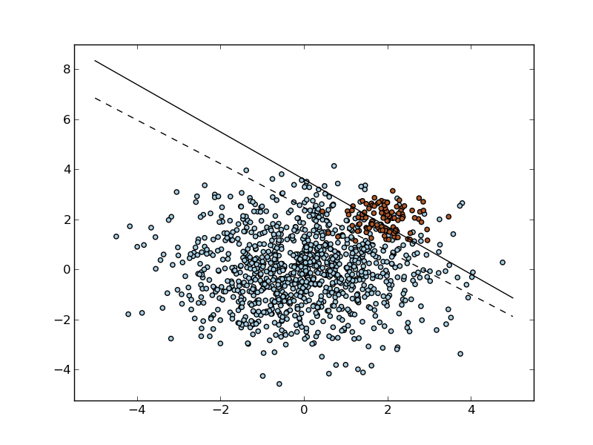
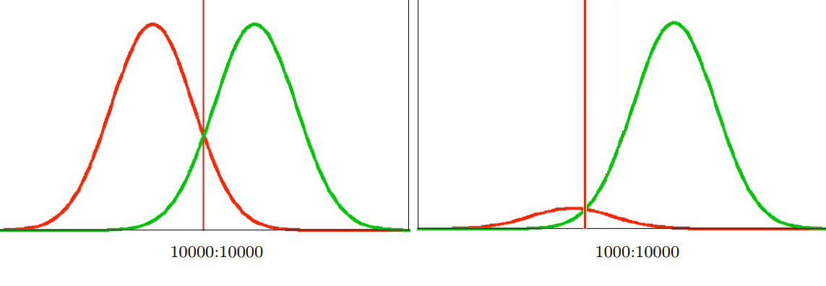
“THE BIAS NAMED CLASS IMBALANCE“
CASE I. - WE DON’T HAVE ENOUGH OF ONE THING
“ T H E B I A S N A M E D C L A S S I M B A L A N C E “
s o u r c e :
“Classification in imbalanced datasets”

Slide 13
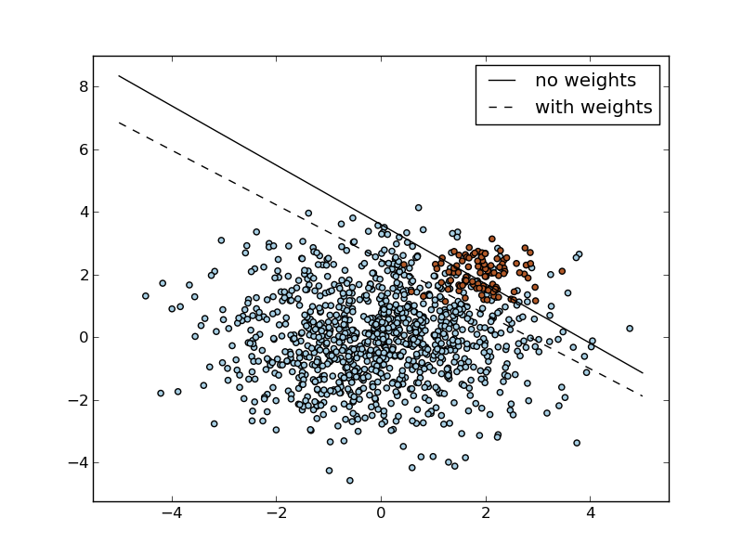
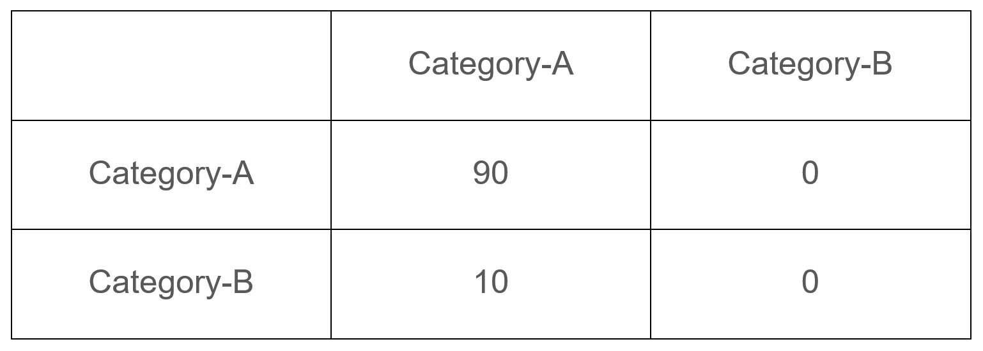
“DATA IS NOT CREATED EQUAL“
SOLUTION 1. - “COST SENSITIVE LEARNING”
Predicted
Actual
We can try to modify our objective / cost calculation to accommodate the fact, that making an error on the minority class is a “more serious issue”.
s o u r c e :
“Cost sensitive learning and the class imbalance problem”

Slide 14
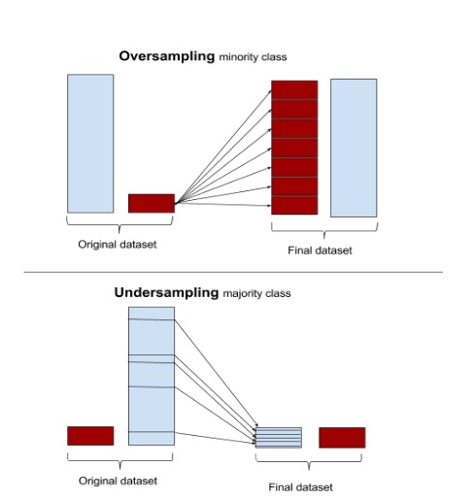
“BIASED COINS FOR THE WIN“
SOLUTION 2. - “SAMPLING”
Oversampling:
Repeatedly use some of the minority class data points
Good question is: Which ones?
Can we be more intelligent then random choice?
Undersampling:
Choose only some of the majority class data points
Reduces the overall dataset, not recommended
s o u r c e :
Undersampling and oversampling questions

Slide 15
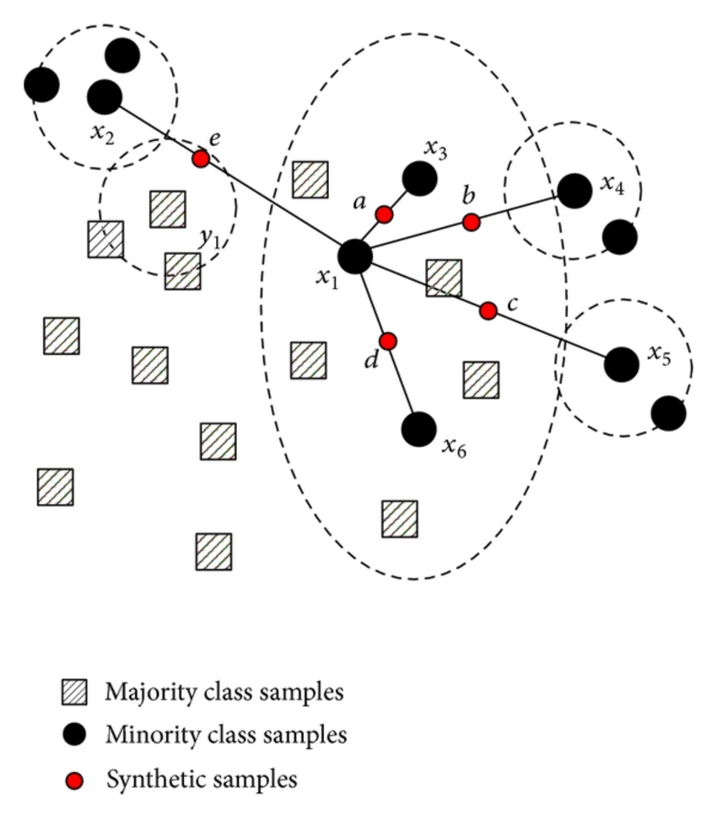
“IF YOU DON’T HAVE IT, CREATE IT“
SOLUTION 3. - DATA SYNTHESIS
Create new data points! (SMOTE)
“First it finds the n-nearest neighbors in the minority class for each of the samples in the class. Then it draws a line between the the neighbors an generates random points on the lines.”
...and add some noise! (ADASYN)
“After creating those sample it adds a random small values to the points thus making it more realistic. In other words instead of all the sample being linearly correlated to the parent they have a little more variance in them i.e they are bit scattered.”
...and use clusters! (Cluster Based Oversampling)
s o u r c e :
SMOTE and ADASYN
“Clustering and Learning from Imbalanced Data”
Notes:
THINK! We are doing something with the data distribution!

Slide 16
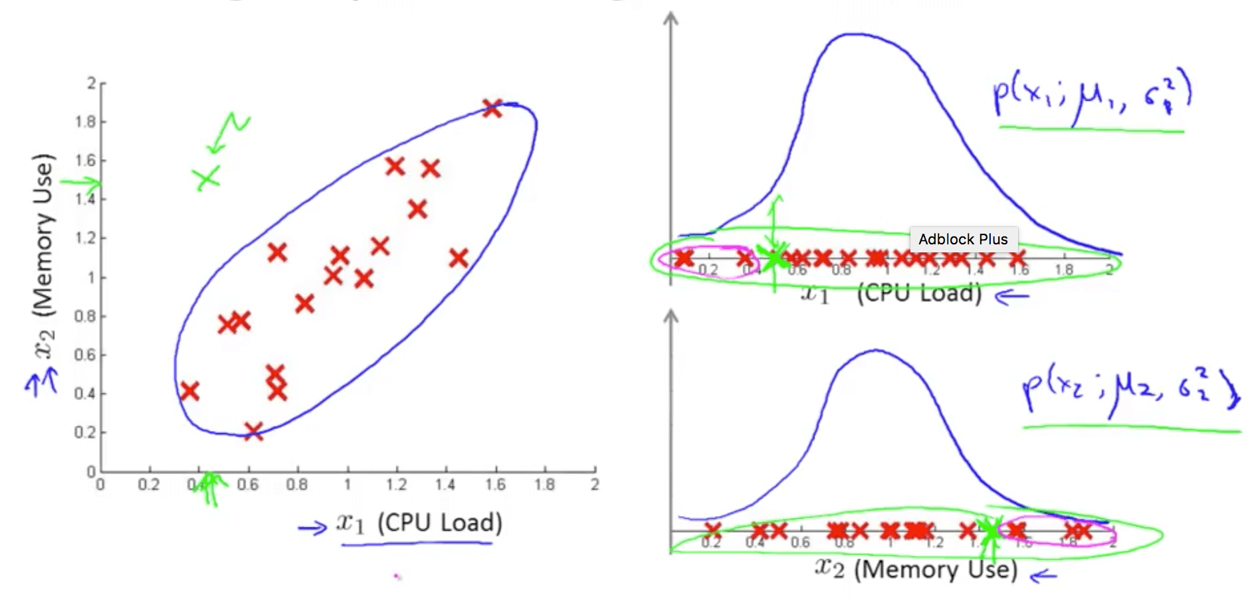
“WELL IF YOU LOOK IT JUST WAY“
SOLUTION 4. - RECAST PROBLEM!
If the minority class points are so rare, they can be considered “exceptions”, or “anomalies”
There are tools for “one class” classification (eg.: “One class SVM” and “Isolation forests”)
But if we basically get a good probabilistic model of the majority class distribution, we are done.
This will lead us to “representation learning”
s o u r c e :
Classification based outlier detection techniques
Anomaly Detection using the Multivariate Gaussian Distribution
Ritchie Ng: Anomaly detection
Notes:
Don’t be mislead, we only need 1 gauss / feature

Slide 17
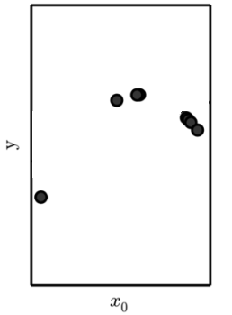
CASE II. - WE DON’T HAVE ENOUGH ANYTHING
S I M P L Y : N O T E N O U G H D A T A

Slide 18
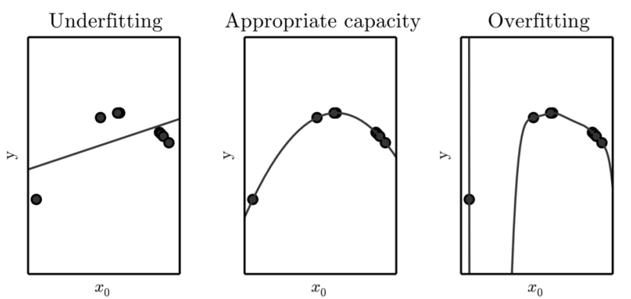
“NOT ENOUGH IN WHAT SENSE”
CONNECTION WITH OVERFITTING
s o u r c e :
Overfitting - Wikipedia
Notes:
with respect to the complexity of the model!

Slide 19
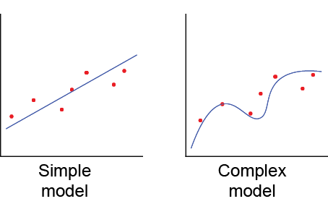
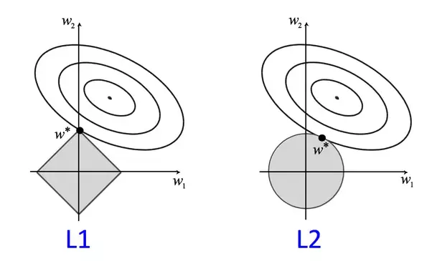
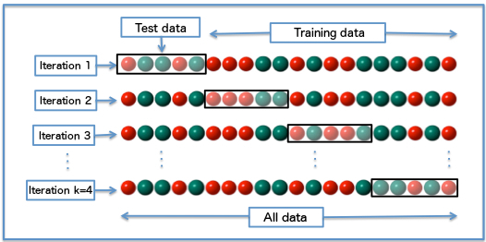
“TRY THE CLASSICS FIRST”
FIRST TRY - CLASSIC METHODS FOR STABILITY
Modify the model:
Use a simple model
We are often forced to use a complex one since the data itself is complex (dimensions, non-linearity…)
Use special models (eg. SUFTware)
Modify the objective:
Add regularization term (Capacity control)
Use “max margin” objective (like in SVMs)
Modify the training:
Use cross-validation for getting a bit more out of the data
Use PU Learning

Slide 20
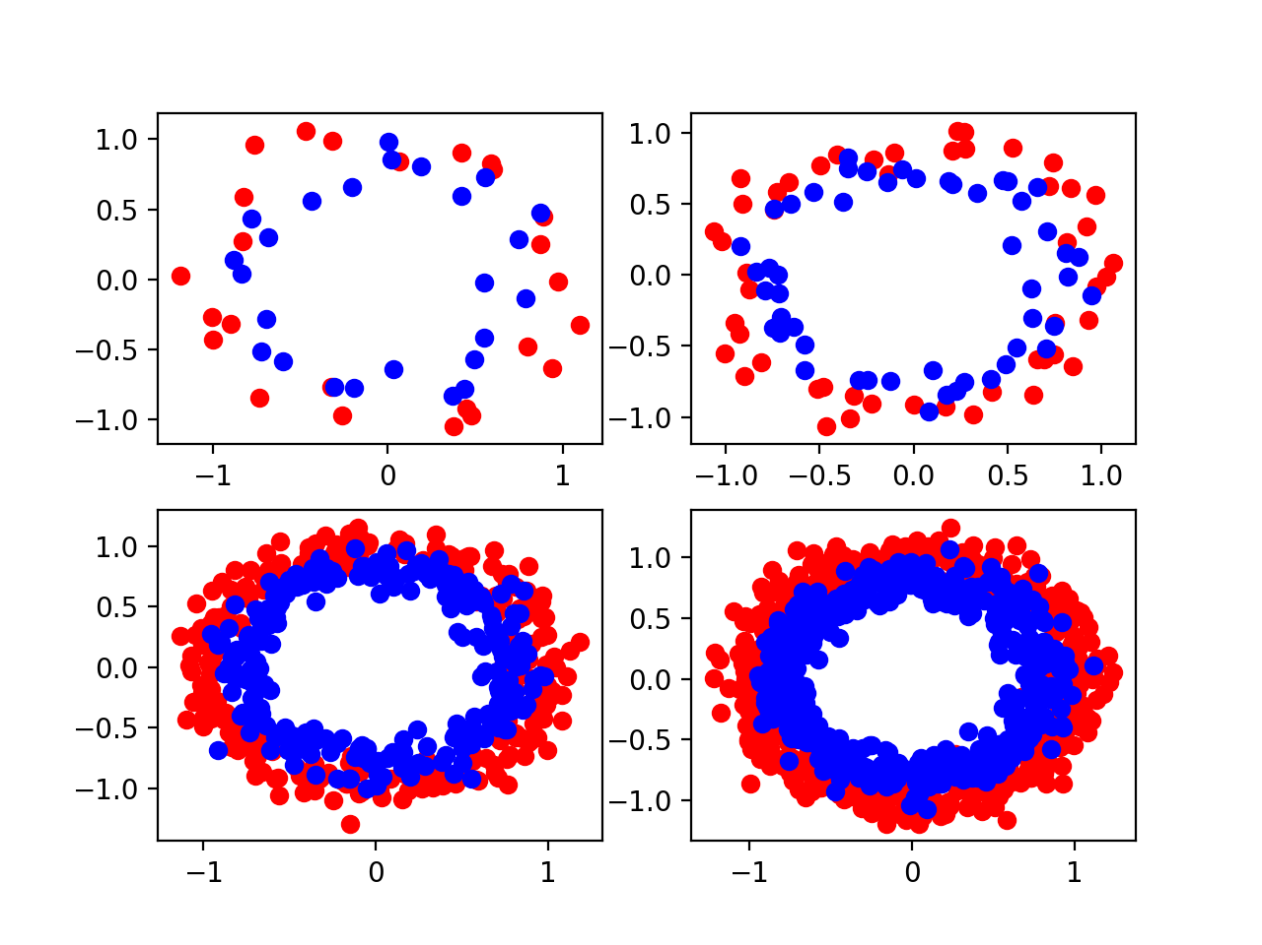
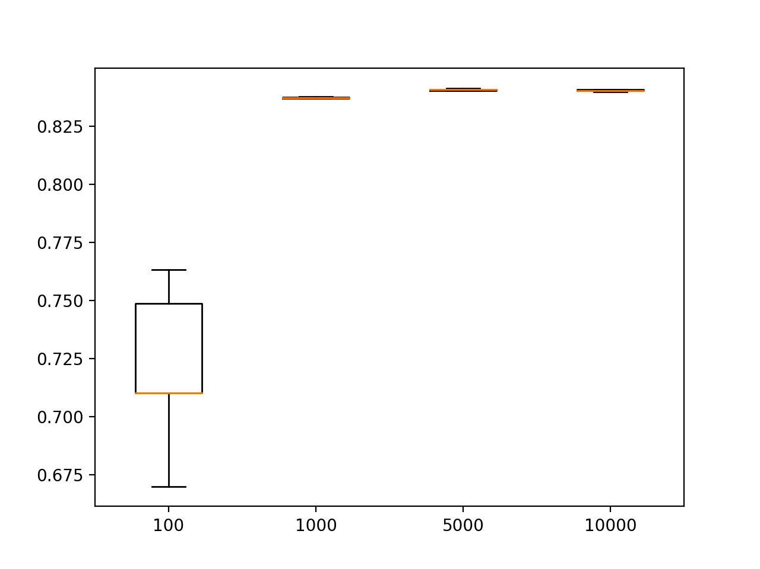
“THE MORE THE MERRIER”
HOW MUCH IS “ENOUGH” FOR A SMALL NEURAL NET?
"...two inputs, 25 nodes in the hidden layer, and one output..."
s o u r c e :
Jason Brownlee: “Impact of dataset size on deep learning model skill and performance estimates”

Slide 21
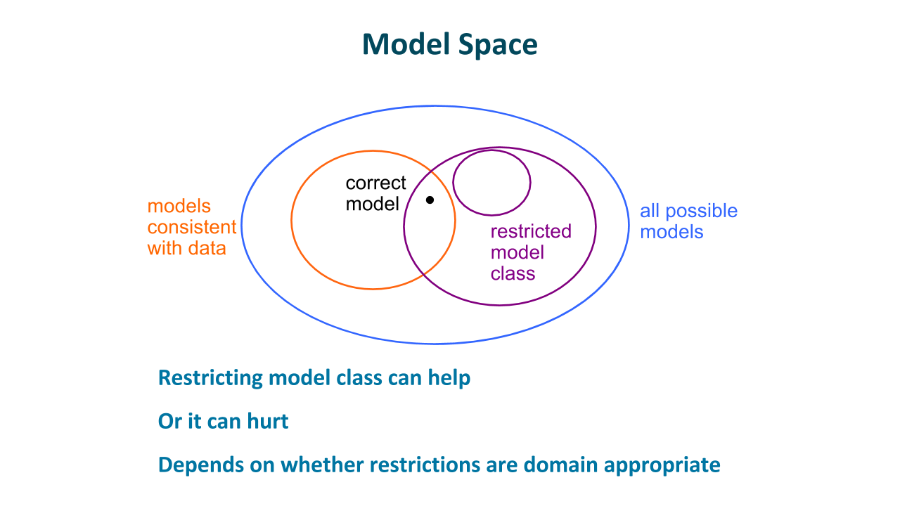
“THE MORE THE MERRIER”
REMARK: ADDING MORE DATA ACTS AS “REGULARIZER”
s o u r c e :
“Lecture series of Michael C. Mozer at DeepLearn2017 Bilbao”

Slide 22
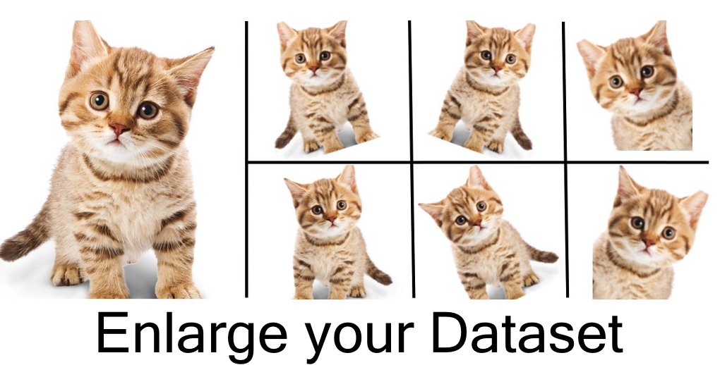
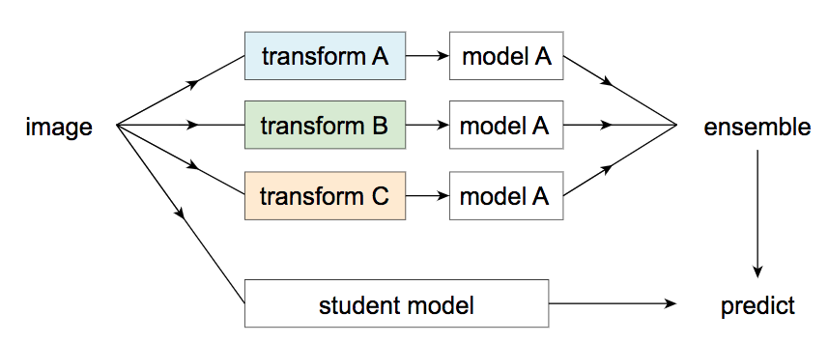
“THE MORE THE MERRIER”
GET MORE “DATA” 1. - GENERATE OR AUGMENT
Data augmentation:
Use simple operations to modify the data
Images: rotate, mirror, crop,...
MUST be realistic for the domain distribution
“Self labeling”:
Transform data, train sub-classifiers, use them on new data, add predictively labelled data to original.
Weak supervision:
Can be, that labels will be noisy - crowdsourcing
s o u r c e :
“Data augmentation - How to use Deep Learning when you have limited data?”
“Data distillation: Towards omni-supervised learning”
“A brief introduction to weakly supervised learning”
“The Quiet Semi-Supervised Revolution”
Notes:
Transformations MUST fall inside the data distribution - at least to respect it’s constraints!!!

Slide 23
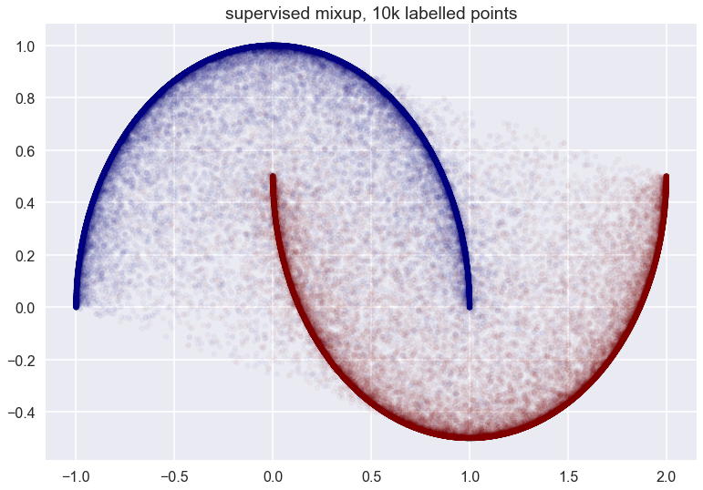
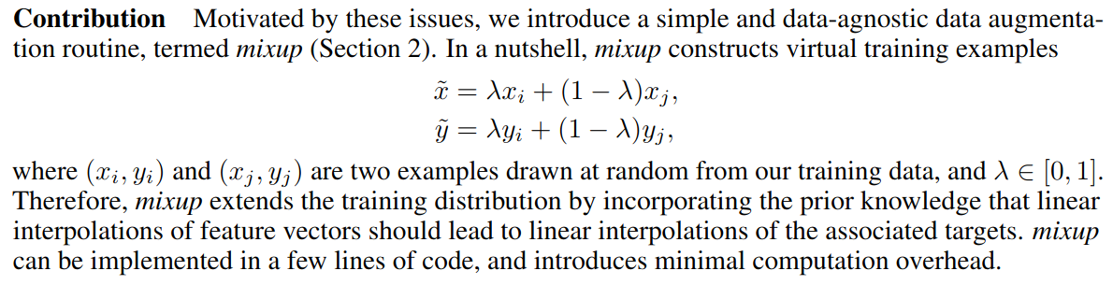
“LEARN THE DISTRIBUTION”
GET MORE “DATA” 1.1 - “MIXUP”
The idea of “Mixup”:
Approximates a whole distribution!
s o u r c e :
Mixup: Beyond empirical risk minimization
Mixup: Data-dependent Data Augmentation (analysis by inFERENCe )”
Notes:
Transformations MUST fall inside the data distribution - at least to respect it’s constraints!!!

Slide 24
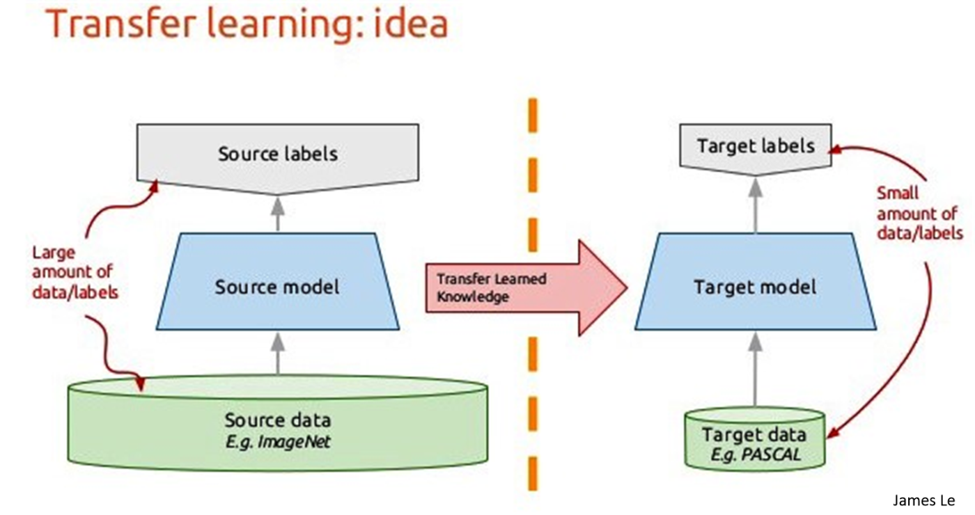
“THE KNOWLEDGE RESIDES WITHIN”
GET MORE “DATA” 2. - TRANSFER IT! (COMPRESSED)
Transfer learning!
A HUGE topic in itself (with more and more sophisticated methods for preventing “catastrophic forgetting”)
We have to see, that models are “storing” data, albeit compressed.
There are plenty of pre-trained models available, USE THEM!
What model to “transfer”?
Notion of “learning a whole representation space” (see eg.: Mixup method)
GANs or VAEs are generally strong candidates (+ few labeled data case)
s o u r c e :
“Transfer Learning - Machine Learning's Next Frontier”
“”Data Augmentation in Emotion Classification Using Generative Adversarial Networks”

Slide 25
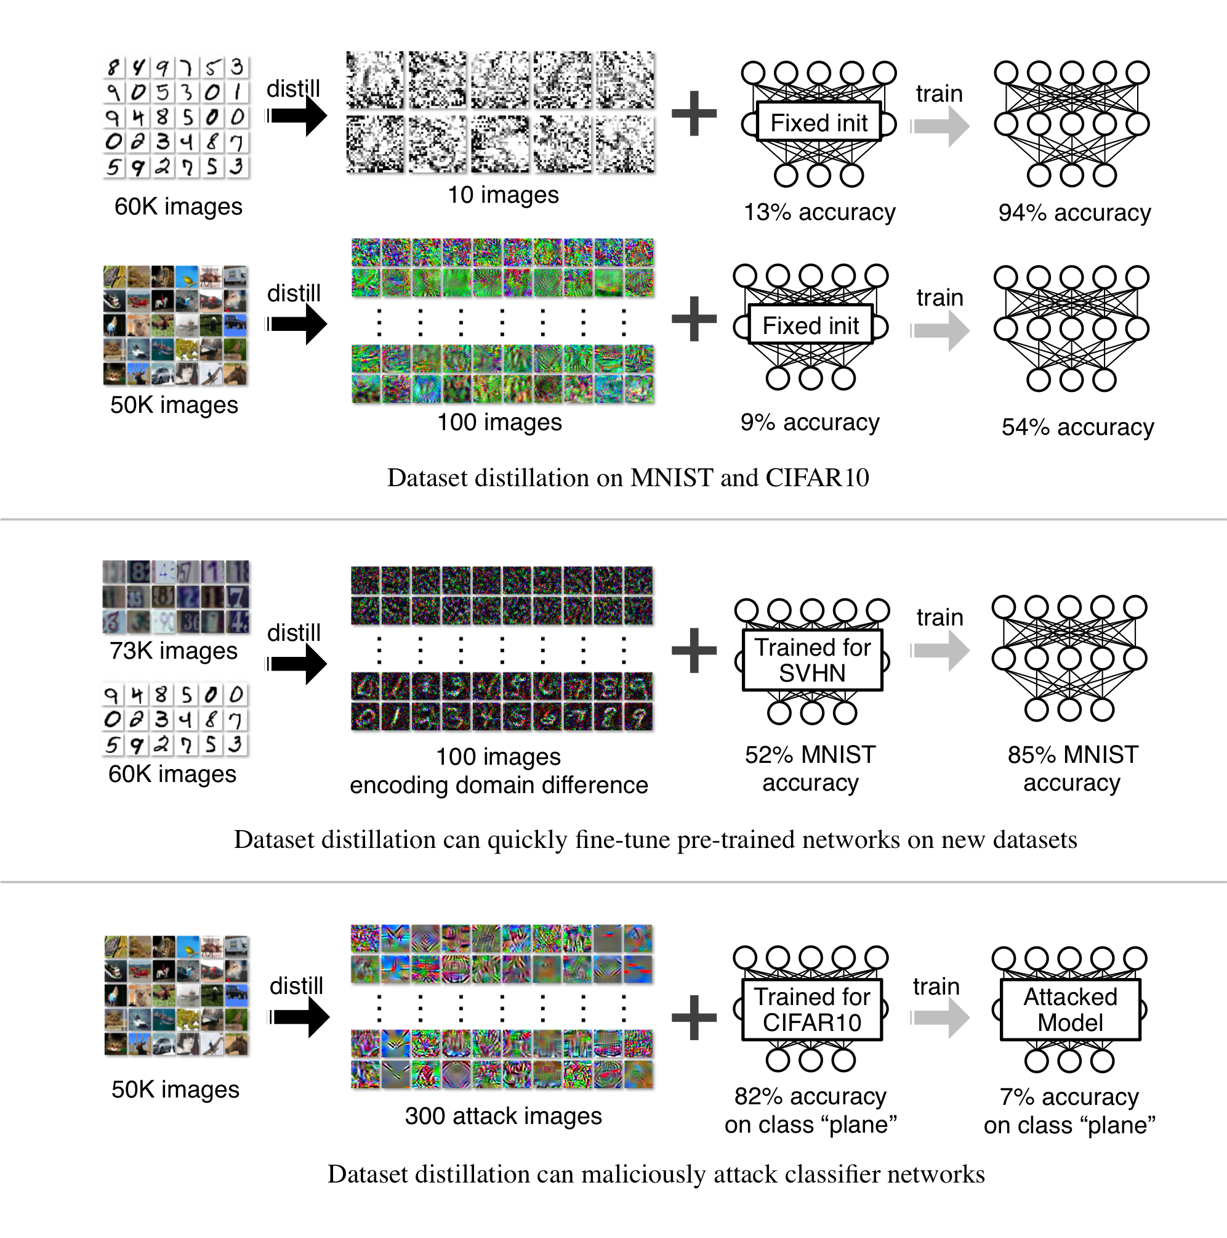
“NOT ALL DATA IS EQUAL”
SIDENOTE: DATASET DISTILLATION
“...The idea is to synthesize a small number of data points that do not need to come from the correct data distribution, but will, when given to the learning algorithm as training data, approximate the model trained on the original data. For example, we show that it is possible to compress 60,000 MNIST training images into just 10 synthetic distilled images (one per class) and achieve close to original performance with only a few steps of gradient descent, given a particular fixed network initialization”
s o u r c e :
Dataset Distillation

Slide 26
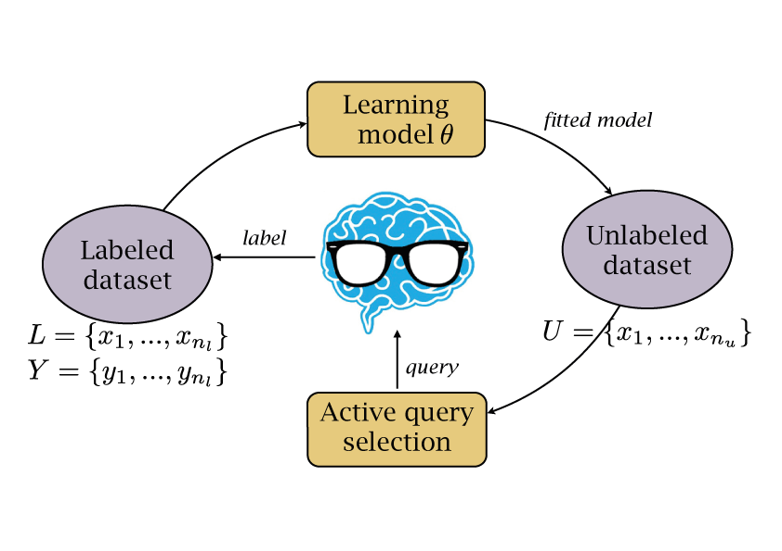
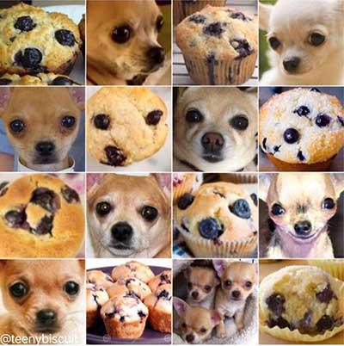
“PLEASE”
GET MORE “DATA” 3. - ASK FOR IT! :-)
Crowdsource!
Amazon Mechanical Turk
or CrowdFlower.
Design a learning loop!
Continuous, Online learning
There are key points worth
asking for
(margin, adversarial examples)
-> Active learning
-> Building Models via Comparisons
s o u r c e :
“Adversarial sampling for active learning”
“Attacking machine learning with adversarial examples”
“ModAL - Active learning with Keras”

Slide 27

CURRENT LIMITATION OF AI:
requires huge amounts of annotated data -> annotation is a big business
Why big tech pays poor Kenyans to teach self-driving cars
Data Annotation: The billion dollar business behind AI breakthroughs

Slide 28
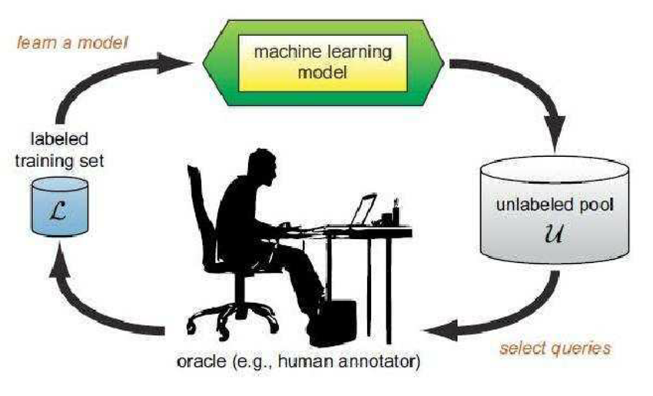
“ANNOTATION AS A SIDE EFFECT”
PROCESS INTEGRATION
Predict
Learn
“Suggestion”
* Annotation!!!
Next Task
Next Solution*
Business process

Slide 29
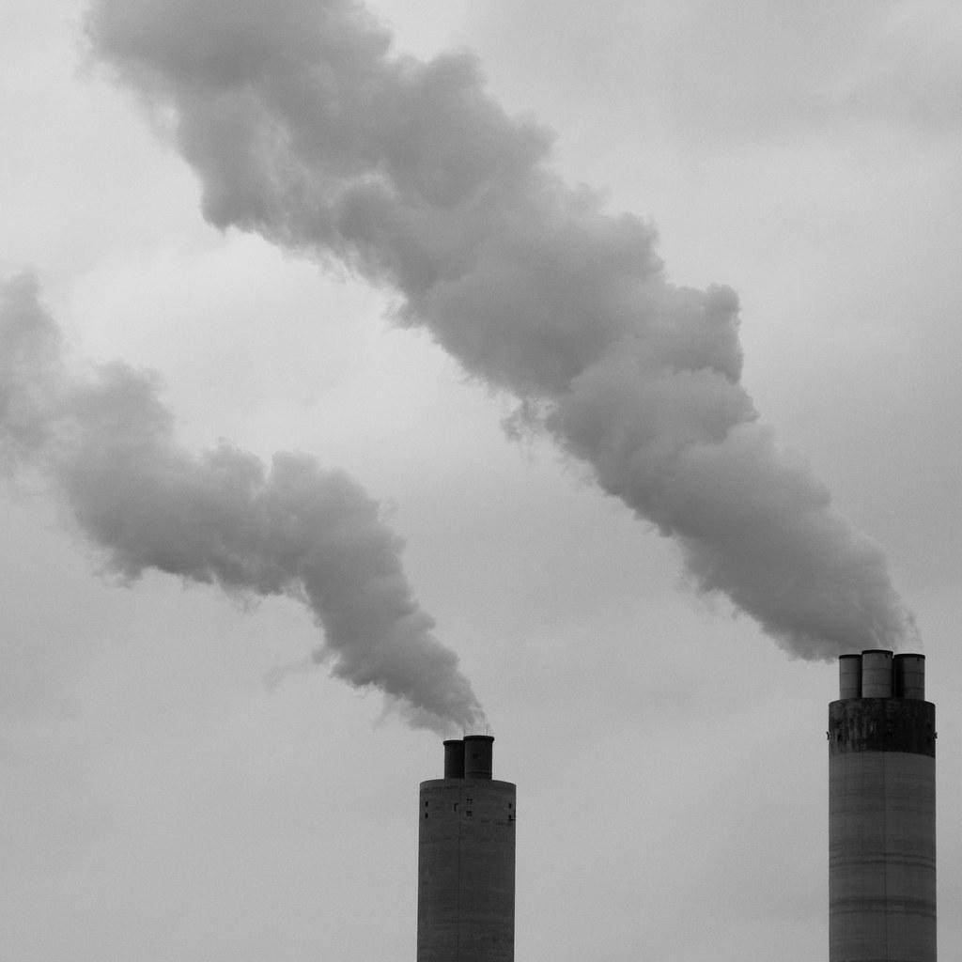
“NOT JUST A SIDE PRODUCT”
DATA EXHAUST - GOLD, WE THROW AWAY
Data exhaust can be annotation too!
“A company that provides IT solutions probably has plenty of data around the transactions executed between their clients and business website. Info related to the initial sign-up and monthly payments can be considered the primary data that easily fits into your big data plans. Supporting details such as what device customers used, the time of day those transactions took place, and the navigational pattern that led them to checkout is the secondary data or exhaust many organizations don’t even bother with."
Data Exhaust – What Is It And Why Should IT Care?
s o u r c e :
Data exhaust

Slide 30
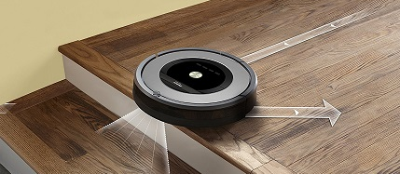
WHAT ARE THE CURRENT LIMITS OF ML?

Slide 31
Limitation 2:
“APPROXIMATION”

Slide 32
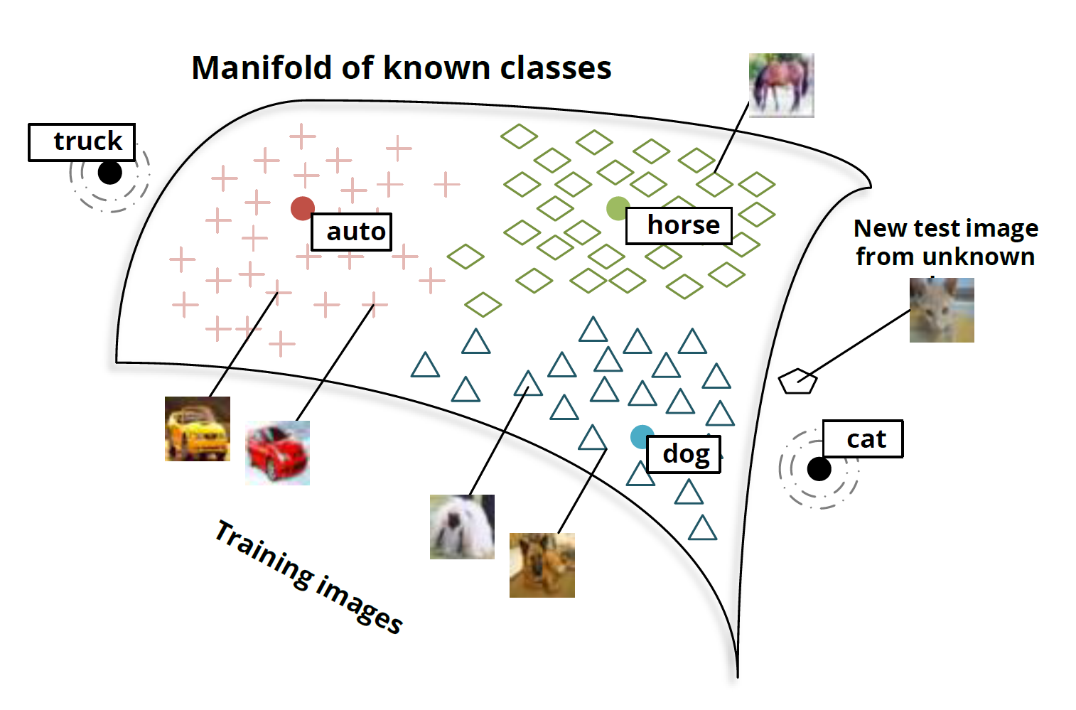
“THE REAL UNKNOWN”
CAN NOT HANDLE UNKNOWN CLASSES!
S O U R C E:
Deep learning, NLP and representations

Slide 33
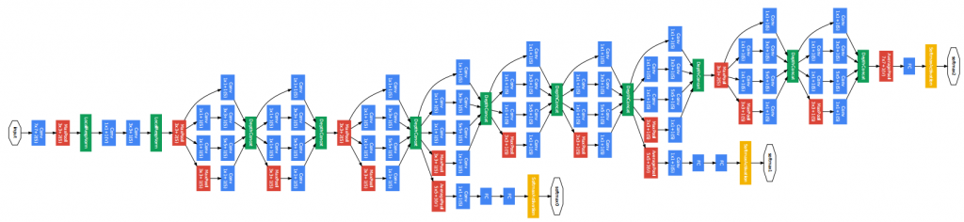
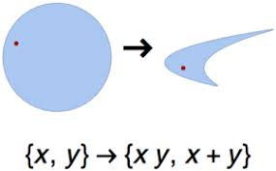
“BLACK BOXES”
THE MODEL IS NOT INTERPRETABLE
MANY LAYERS + NON-LINEAR TRANSFORMATIONS !
S O U R C E:
Neural image captioning for mortals

Slide 34
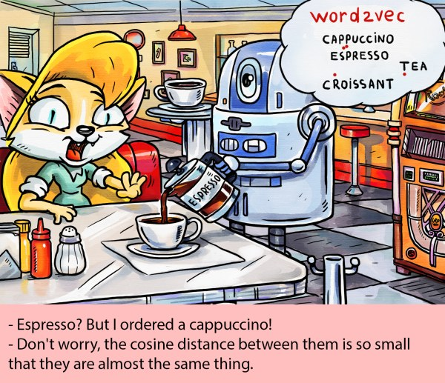
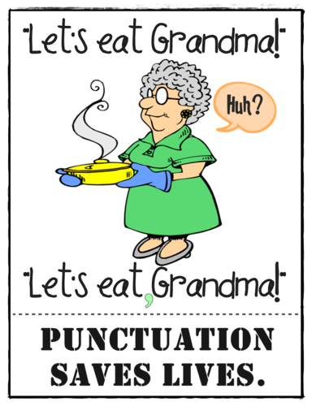
“CLOSE ENOUGH”
REPRESENTATIONS ARE NOT “CRISP”

Slide 35
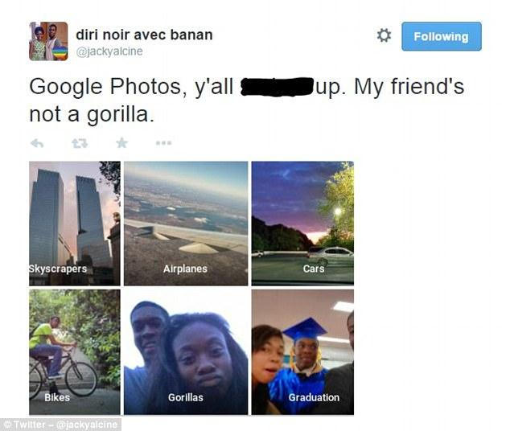
WHEN IT FAILS, IT FAILS BIG TIME - WHY?
!!!
SOURCE:
GOOGLE APOLOGIZES FOR PHOTO APP’S RACIST BLUNDER”

Slide 36
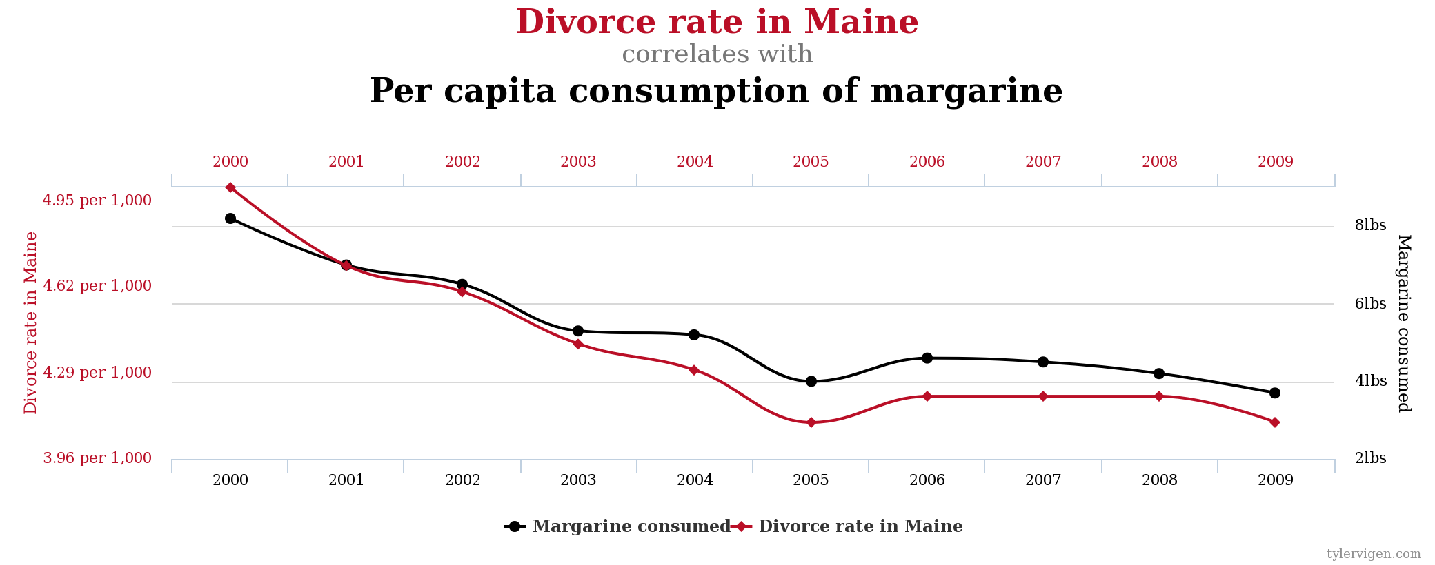
“REPEAT IT ENOUGH AND IT BECOMES TRUE?”
IT HAS TO RELY ON CORRELATIONS
SOURCE:
“Spurious correlations website”

Slide 37
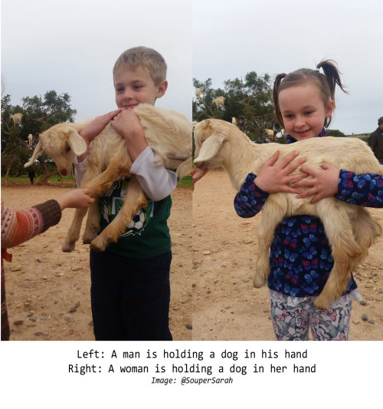
“REPEAT IT ENOUGH AND IT BECOMES TRUE?”
IT HAS TO RELY ON CORRELATIONS
SOURCE:
“DO NEURAL NETWORK DREAM OF ELECTRIC SHEEP?”

Slide 38

“WATCH THE TRAIL!”
LEARNS FROM RAW INPUT - NO OBJECT CONCEPT
POSSIBLE “CURE”:
“GOOGLE’S AI WIZARD UNVEILS A NEW TWIST ON NEURAL NETWORKS”

Slide 39
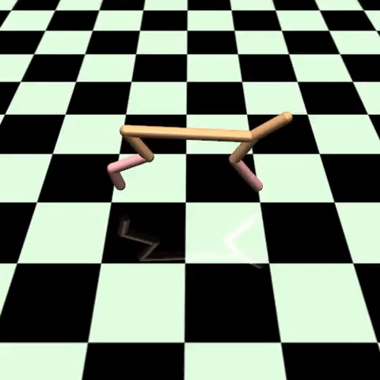
“BUT IT JUST WORKS, ISN’T IT?”
NO CONCEPT OF A “GOOD SOLUTION”
SOURCE
“Deep reinforcement learning does not work yet

Slide 40
Limitation 3:
“BIAS”

Slide 41


“FOR THE COMMON(?) GOOD (?)?”
THE DANGEROUS CASE OF PREDICTING CRIME

Slide 42
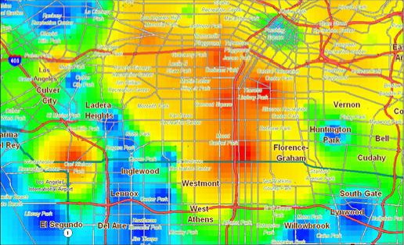
“FOR THE COMMON(?) GOOD (?)?”
THE DANGEROUS CASE OF PREDICTING CRIME
SOURCE
In Los Angeles, using statistics to predict crime

Slide 43
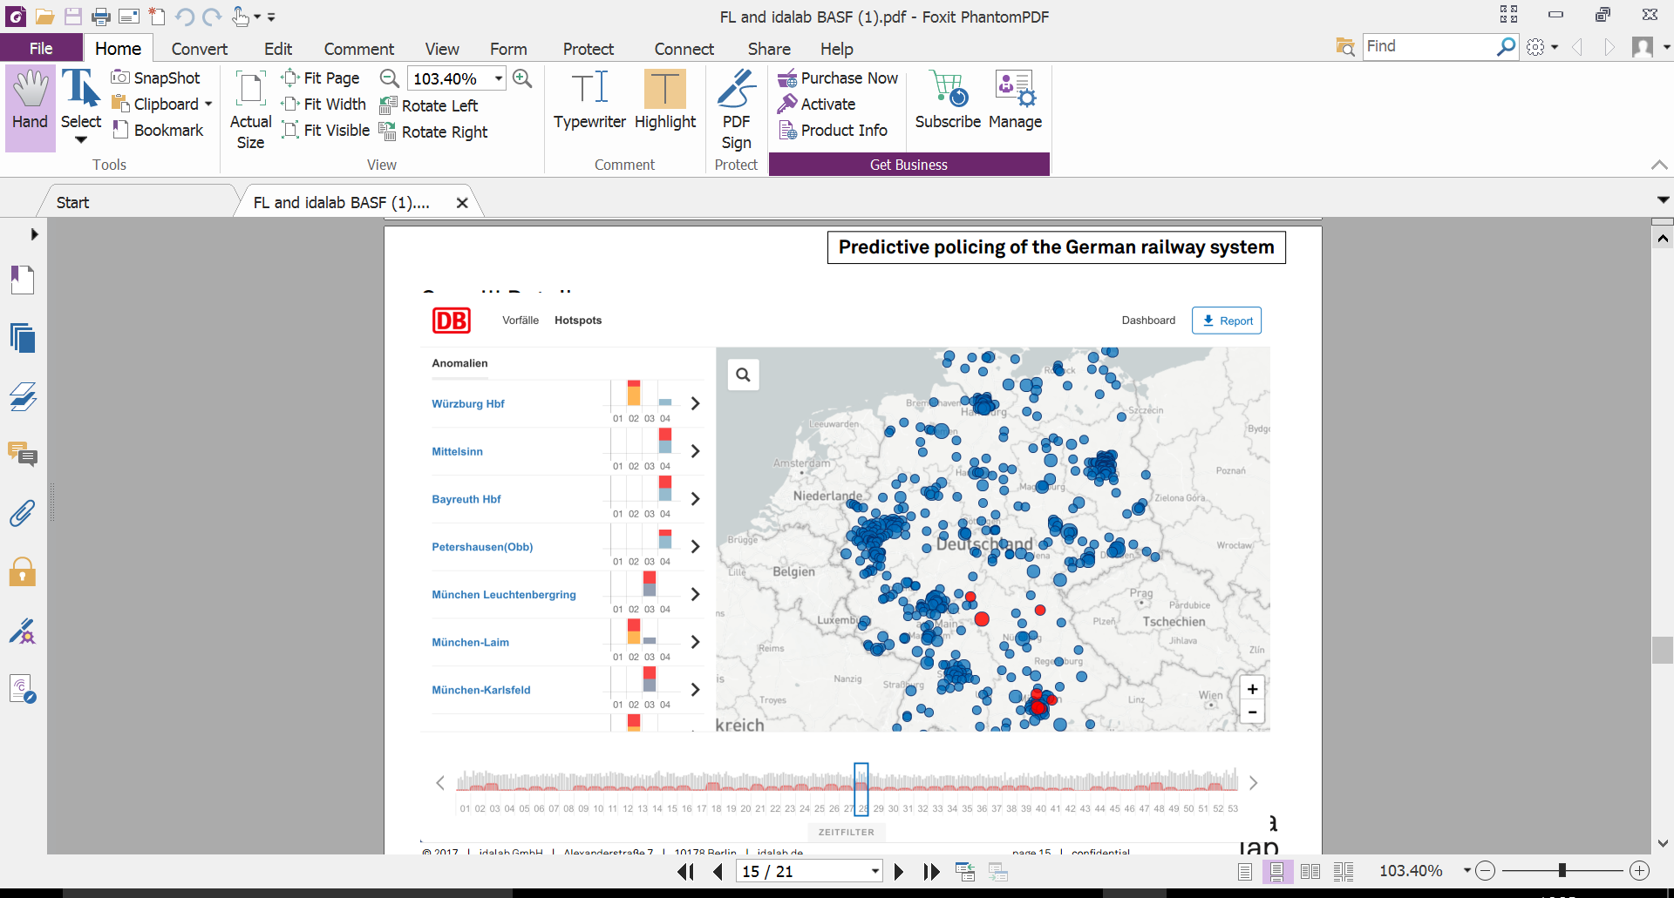
PREDICTIVE POLICING FOR THE GERMAN RAILWAYS

Slide 44
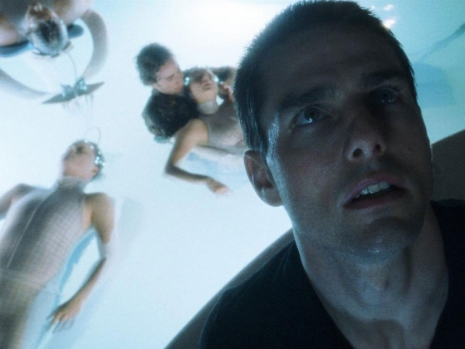
“FOR THE COMMON(?) GOOD (?)?”
FREE WILL? - BIAS!
The film posed the dilemma of predictability vs. free will. This is a valid philosophical concern.
See more on this topic in Harari’s The myth of freedom.
But what if the problem arises on an even more trivial level?

Slide 45
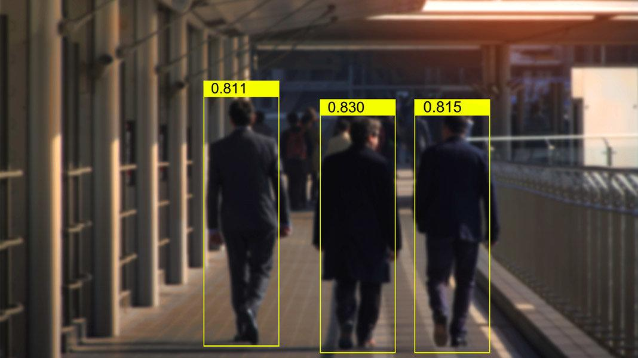
“EMPIRICAL???”
LEARNS OUR BIAS AND PREJUDICE (DATA!!!)
S O U R C E:
“Predictive policing is a scam that perpetuates systemic bias”
“Beyond GIGO: how "predictive policing" launders racism, corruption and bias to make them seem empirical”

Slide 46
Limitation 3:
“ATTACKABILITY”

Slide 47

“JUST SAY WHAT I SAY!”
CAN BE ACTIVELY TAUGHT TO BIAS, PREJUDICE
S O U R C E:
“ MICROSOFT DELETES RACIST GENOCIDAL TWEETS FROM AI CHATBOT”
“MAN IS TO COMPUTER PROGRAMMER AS WOMAN IS TO HOMEMAKER”

Slide 48


“JUST WATCH MY HAND!”
IT CAN BE CONFUSED WITH “ADVERSARIAL EXAMPLES”
SOURCE:
“”ATTACKING MACHINE LEARNING WITH ADVERSARIAL EXAMPLES

Slide 49
Conclusion:
“COOPERATIVE SYSTEMS”

Slide 50



“INEFFECTIVE + FAILURE PRONE”
REPLACING YOUR WORKFORCE?
DO NOT!

Slide 51

DON’T REPLACE, AUGMENT!
COOPERATIVE SYSTEMS ARE MINIMIZING RISK
Artificial intelligence VS Augmented intelligence

